Slide 1
In the back of your books
Find the missing number in each of these pairs of matching ratios
1:3 = 4:?
5:6 = ?:30
48:8 = ?:1
1:3 = 12:?
3:9 = ?:54
4:? = 16:20
.?:15 = 30:45
4:20 = 24:?
5:8 = ?:64
13:33 = ?:99
13:? = 169:26

Slide 2
Inequalities
Aims – To be able to understand and use inequality symbols

Slide 3
Inequalities
Not equal to
More Than
or
Less Than

Slide 4
More Than/ Greater Than
>
Greater Than
≥
Greater Than or Equal to
e.g. x > 4
x is greater than 4
e.g. x ≥ 3
x is greater than or equal to 3

Slide 5
e.g. x > 4
x is greater than 4
x could be 5,6,7 or any number which is larger than 4
e.g. x ≥ 3
x is greater than or equal to 3
x could be 4,5,6 or any number larger than 3. It can also be 3 exactly

Slide 6
1. In your books copy and write five possible whole numbers which x can be for each inequality
x > 2
x > 11
x > 30
x > 24
x > -3
x ≥ 12
x ≥ 18
8. x ≥ 3

Slide 7
Less Than
<
Less Than
≤
Less Than or Equal to
e.g. x < 7
x is less than 7
e.g. x ≤ 2
x is less than or equal to 2

Slide 8
e.g. x < 7
x is less than 7
x could be 6,5,4 or any number which is less than 7
e.g. x ≤ 2
x is less than or equal to 2
x could be 1,0,-1 or any number less than 2. It can also be 2 exactly

Slide 9
2. In your books copy and write five possible whole numbers which x can be for each inequality
x < 10
x < 93
x < -5
x ≤ 6
x ≤ 1321
x ≤ 0

Slide 10
9 < x < 15
x is between 9 and 15
It is greater than 9
It is less than 15
What are all the possible whole number values of x?
10, 11, 12, 13, 14

Slide 11
23 < x ≤ 26
x is between 23 and 26
It is greater than 23
It is less than or equal to 26
What are all the possible whole number values of x?
24, 25, 26

Slide 12
31 ≥ x ≥ 27
x is between 31 and 27
It is less than or equal to 31
It is greater than or equal to 27
What are all the possible whole number values of x?
27, 28, 29, 30, 31

Slide 13
3. In your books copy and write all whole numbers which x can be for each inequality
5 < x < 10
11 < x < 16
28 < x < 35
101 < x < 108
-5 < x < 0
3 ≤ x ≤ 7
12 ≤ x ≤ 19
108 ≤ x ≤ 114
-2 ≤ x ≤ 3
-14 ≤ x ≤ -10

Slide 14
Inequalities on a Number Line
3 ≤ x < 8
3
4
5
6
7
8
x is between 3 and 8
x can be equal to 3
x can’t be equal to 8

Slide 15
Coloured in circles can be equal to, greater than or less than
Empty circles are just greater than or less than

Slide 16
Inequalities on a Number Line
x ≥ 4
3
4
5
6
7
8
x is greater than or equal to four
Can be equal to so use full circle
x can then be any number from 4 onwards
How would we draw that on our number line?

Slide 17
An arrow is used when it is not between two values
Example
20
30
40
50
60
70
x < 60

Slide 18
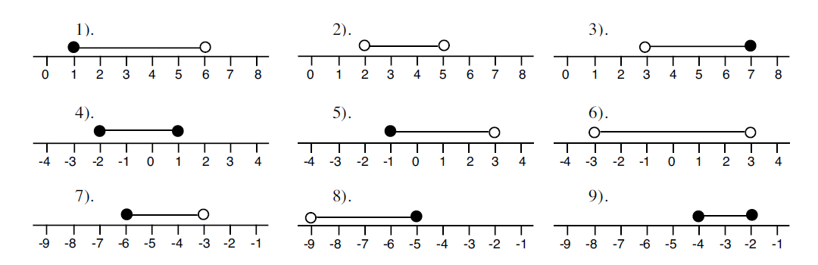
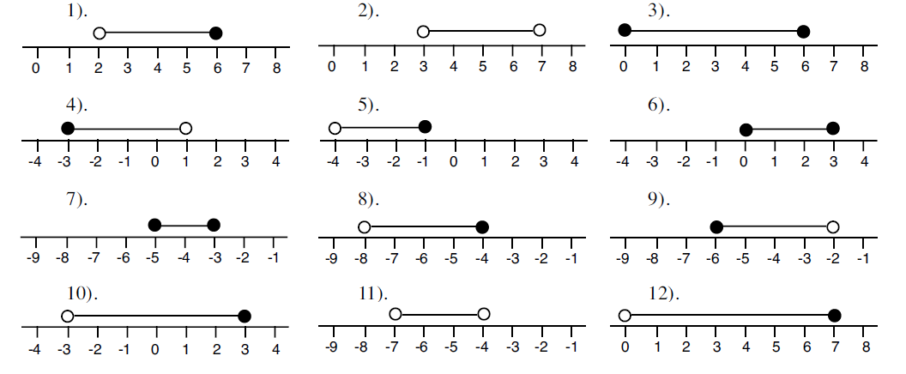
Write down all possible whole numbers which these inequalities can represent

Slide 19
Represent these inequalities on your number lines
x > 2
x < 5
x ≥ -3
x ≤ -1
x ≤ -9
3 ≤ x ≤ 7
2 < x ≤ 10
-3 ≤ x < 6
-8 ≤ x ≤ 4
-6 < x < 0
In your books draw your own number lines to represent
x > 35
x ≤ 180
x ≥ 19
210 ≤ x ≤ 250
-35 < x ≤ -10
1500 < x < 4500

Slide 20
Inequality Bingo
Draw a three by three grid and pick any 9 of the number below to fill it
15
78
-22
1500
3
143
200
-450
8
-100
42
51
-13
-27
121
0
293
Cross of your number if it can be included in each inequality

Slide 21
40 < x < 43
42

Slide 22
-105 < x ≤ -100
-100

Slide 23
-25
-20
-15
-10
-5
0
-22

Slide 24
49 ≤ x < 52
51

Slide 25
0
1
2
3
4
3

Slide 26
-13 ≤ x < -9
51

Slide 27
13
14
15
16
17
18
15

Slide 28
-25 ≤ x ≤ -28
27

Slide 29
70
75
80
85
90
78

Slide 30
120 < x ≤ 121
121

Slide 31
125
130
135
140
145
143

Slide 32
-1 < x < 1
0

Slide 33
-500
-450
-400
-350
-300
-250
-450

Slide 34
292 < x < 294
293

Slide 35
500
1000
1500
2000
1500

Slide 36
5 < x < 10
8

Slide 37
50
100
150
200
250
200

